Slide 1
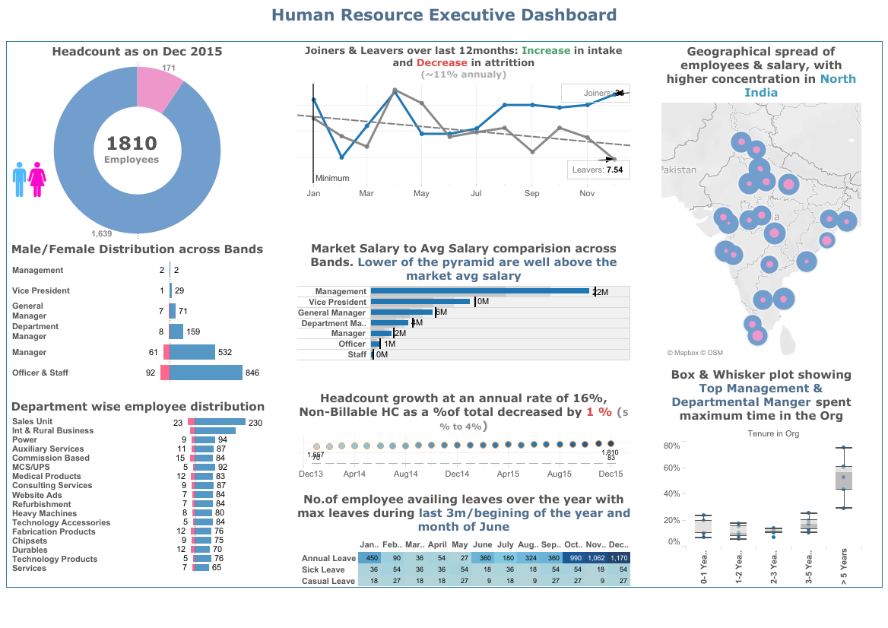
Employee Retention Dash Board analysis
Mel Schwan
DDS Analytics, Inc.

Slide 2

Predicting Employee departure
Our mission is to analyze and predict the employee that has a high potential for leaving the corporation

Slide 3
Agenda
Analysis of the attrition dataset
Basic conclusions
Any trends in organizations and job type
What data points can predict an employee departure
Next steps

Slide 4

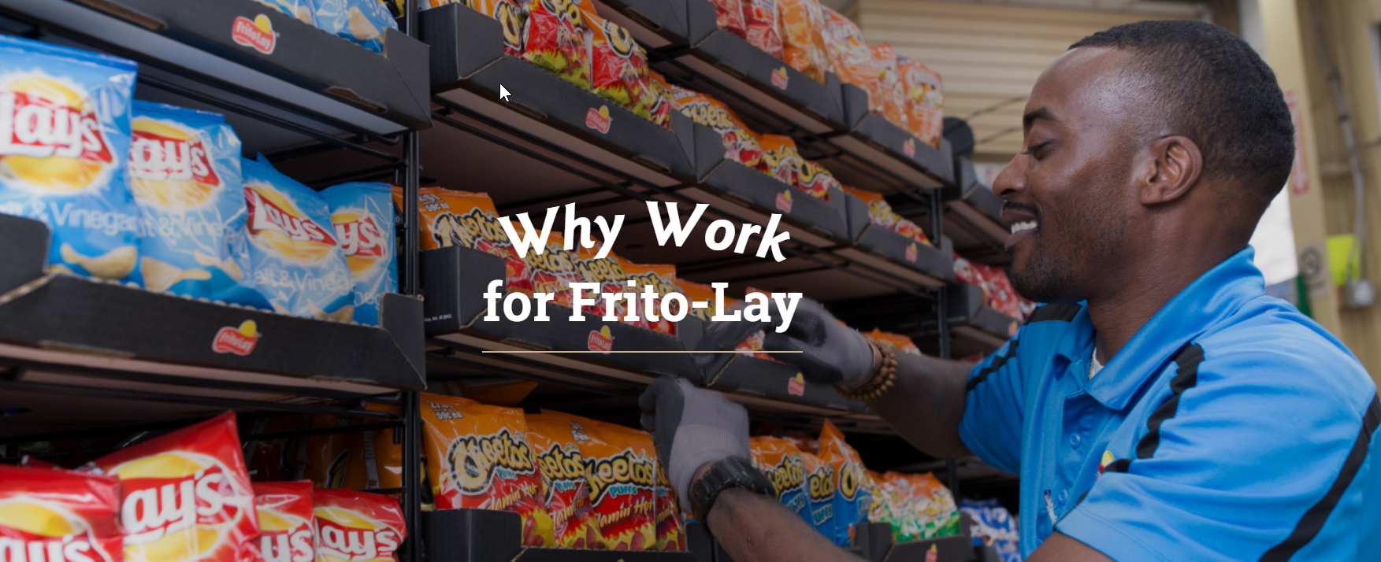
Retaining employees
Predict when they might be leaving and correct areas that may prevent this
Notes:
Notes notes

Slide 5
Frito lays employment data

Slide 6
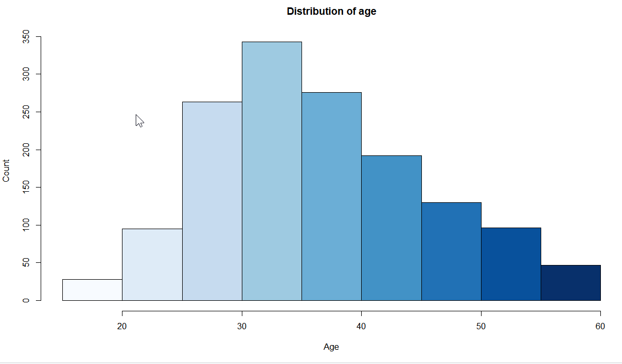
Average age of employee

Slide 7
Distribution of monthly income

Slide 8
Last Breweries Combined Beer
Beer_name | Beer_ID | ABV | IBU | Brewery_id | Style | Ounces | Brewery_name | City | State | ABV_rating | IBU_rating
Rocky Mountain Oyster Stout | 1035 | 0.075 | NA | 425 | American Stout | 12 | Wynkoop Brewing Company | Denver | CO | high | NA
Belgorado | 928 | 0.067 | 45 | 425 | Belgian IPA | 12 | Wynkoop Brewing Company | Denver | CO | high | medium
Rail Yard Ale | 807 | 0.052 | NA | 425 | American Amber / Red Ale | 12 | Wynkoop Brewing Company | Denver | CO | low | NA
B3K Black Lager | 620 | 0.055 | NA | 425 | Schwarzbier | 12 | Wynkoop Brewing Company | Denver | CO | medium | NA
Silverback Pale Ale | 145 | 0.055 | 40 | 425 | American Pale Ale (APA) | 12 | Wynkoop Brewing Company | Denver | CO | medium | medium
Rail Yard Ale (2009) | 84 | 0.052 | NA | 425 | American Amber / Red Ale | 12 | Wynkoop Brewing Company | Denver | CO | low | NA

Slide 9
What Data Was Missing?
ABV > 2.57% IBU > 41.7% Style > 0.21%

Slide 10
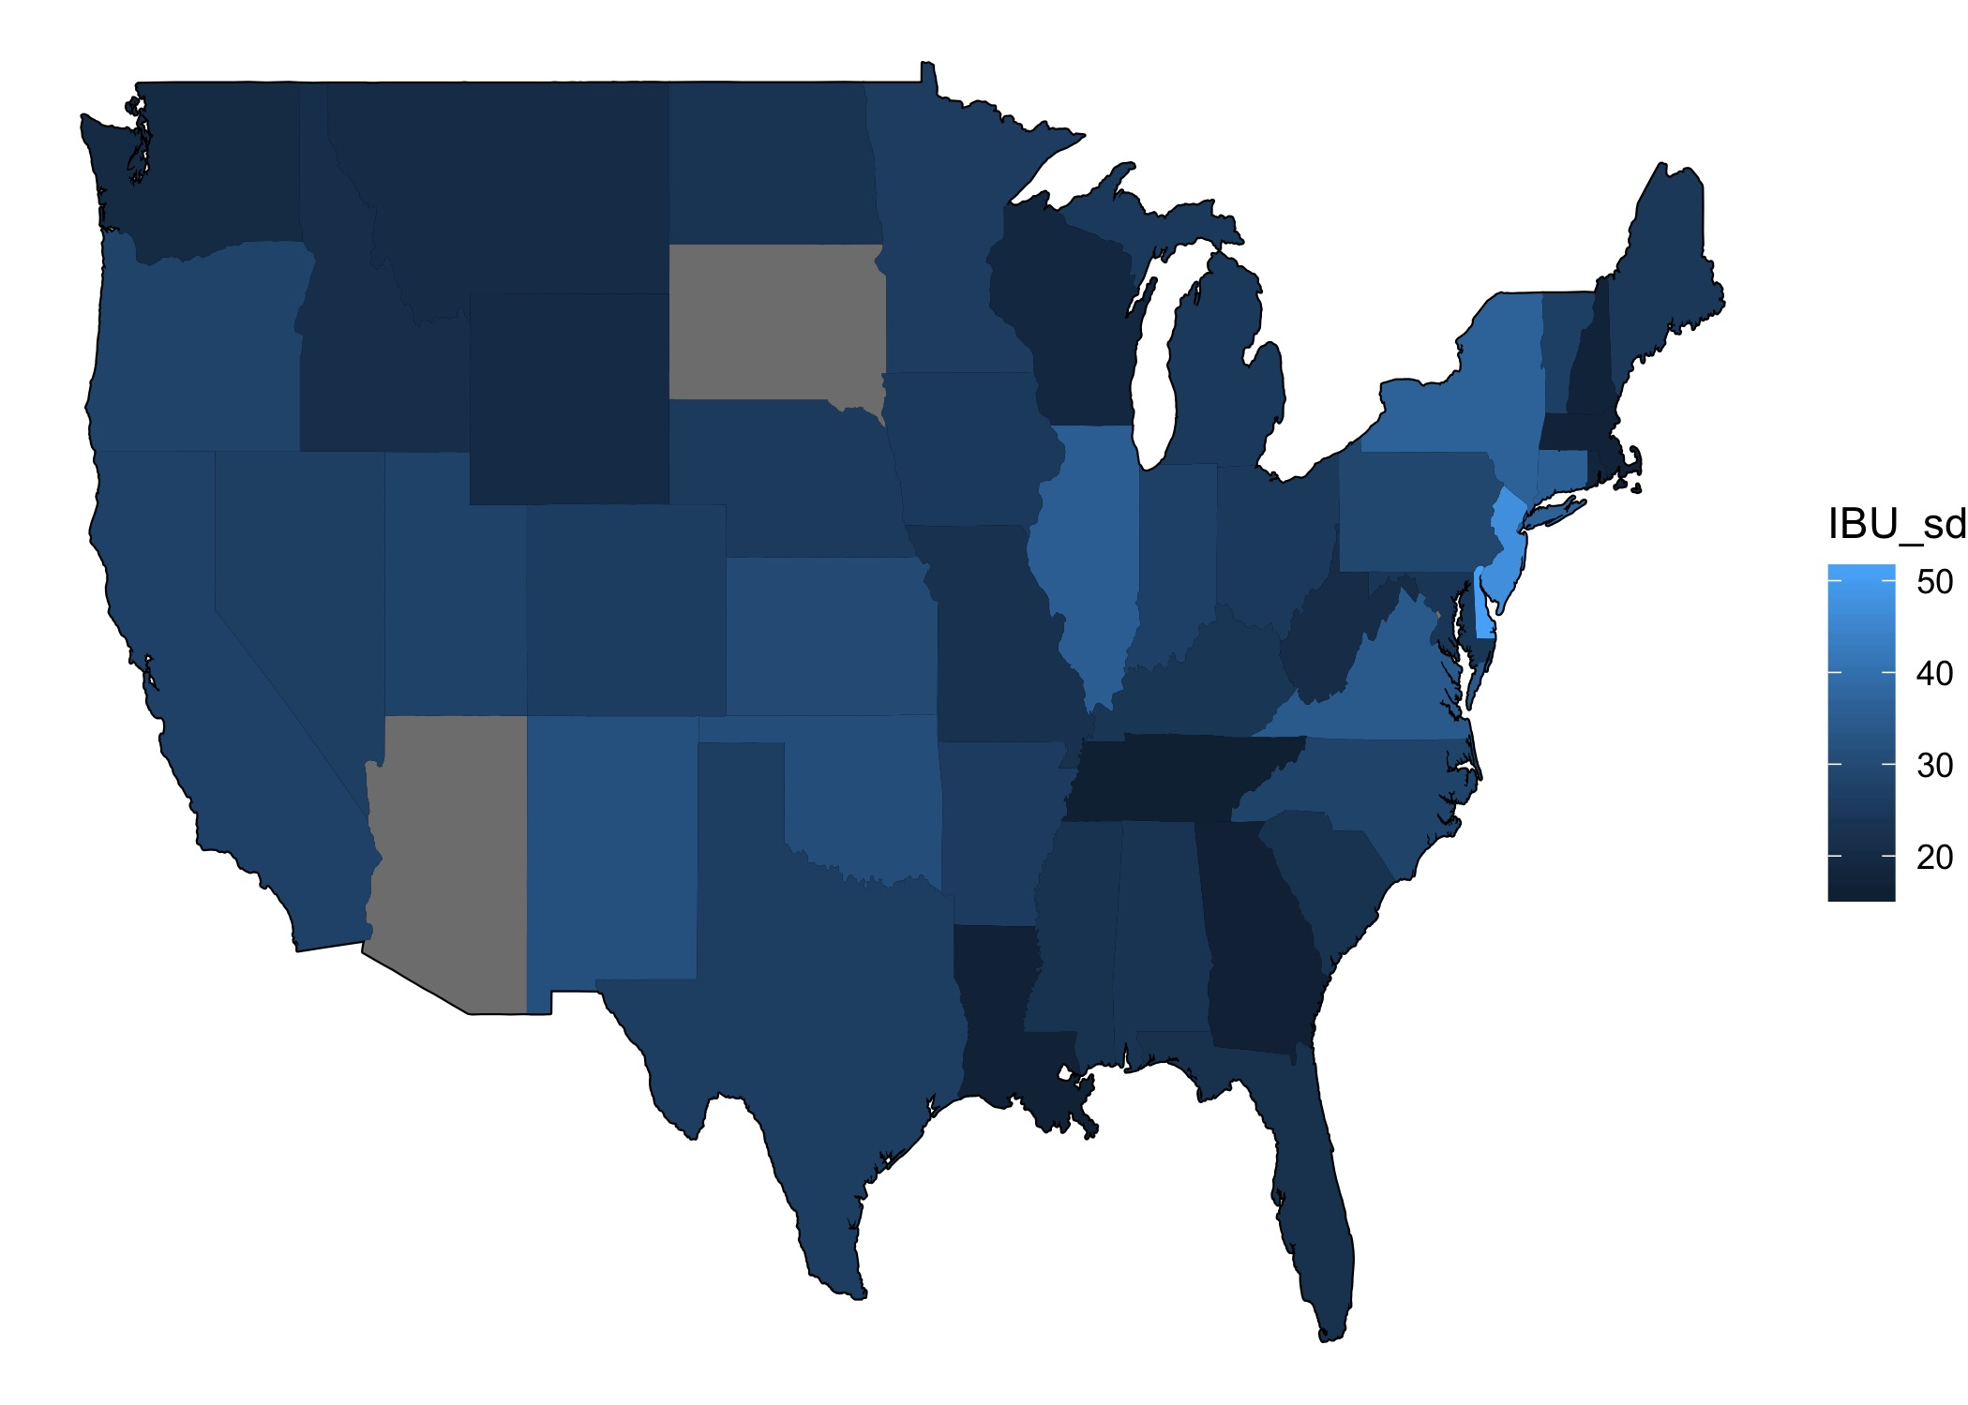
States IBU Standard Deviation

Slide 11
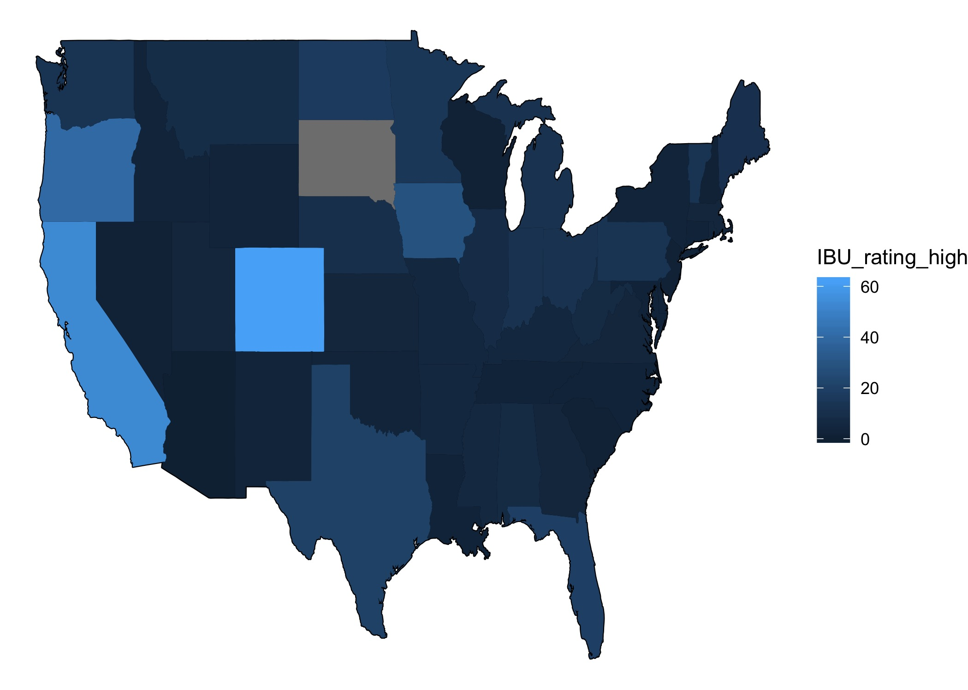
States IBU High

Slide 12
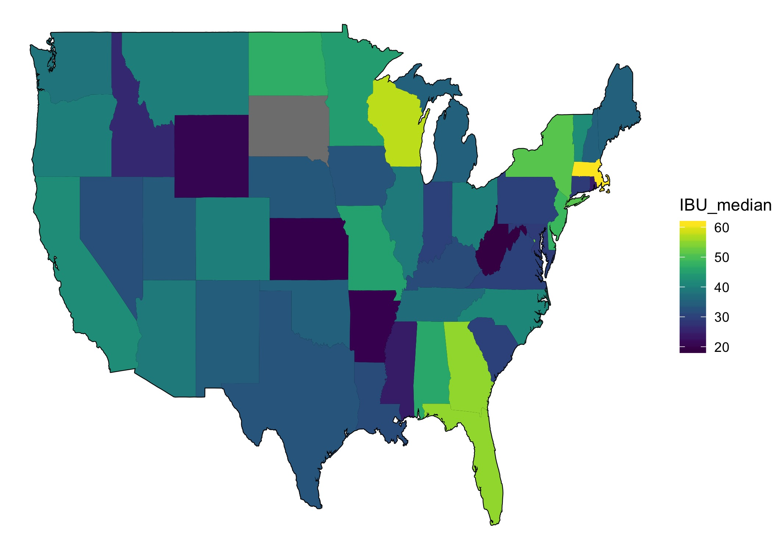
States IBU Ratings

Slide 13
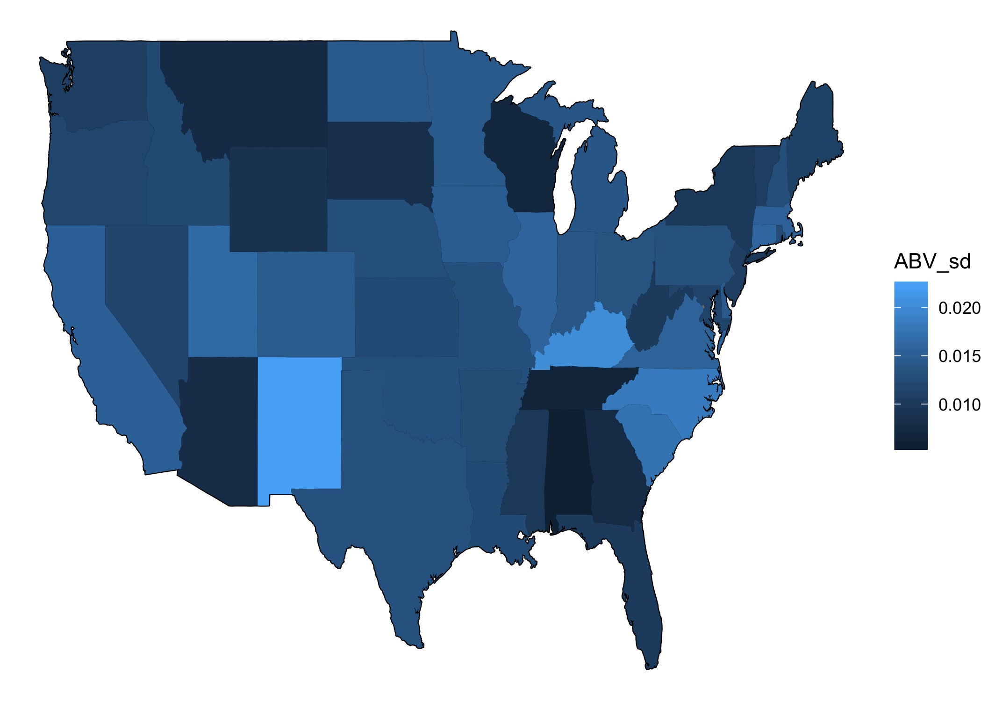
States ABV Standard Deviation

Slide 14
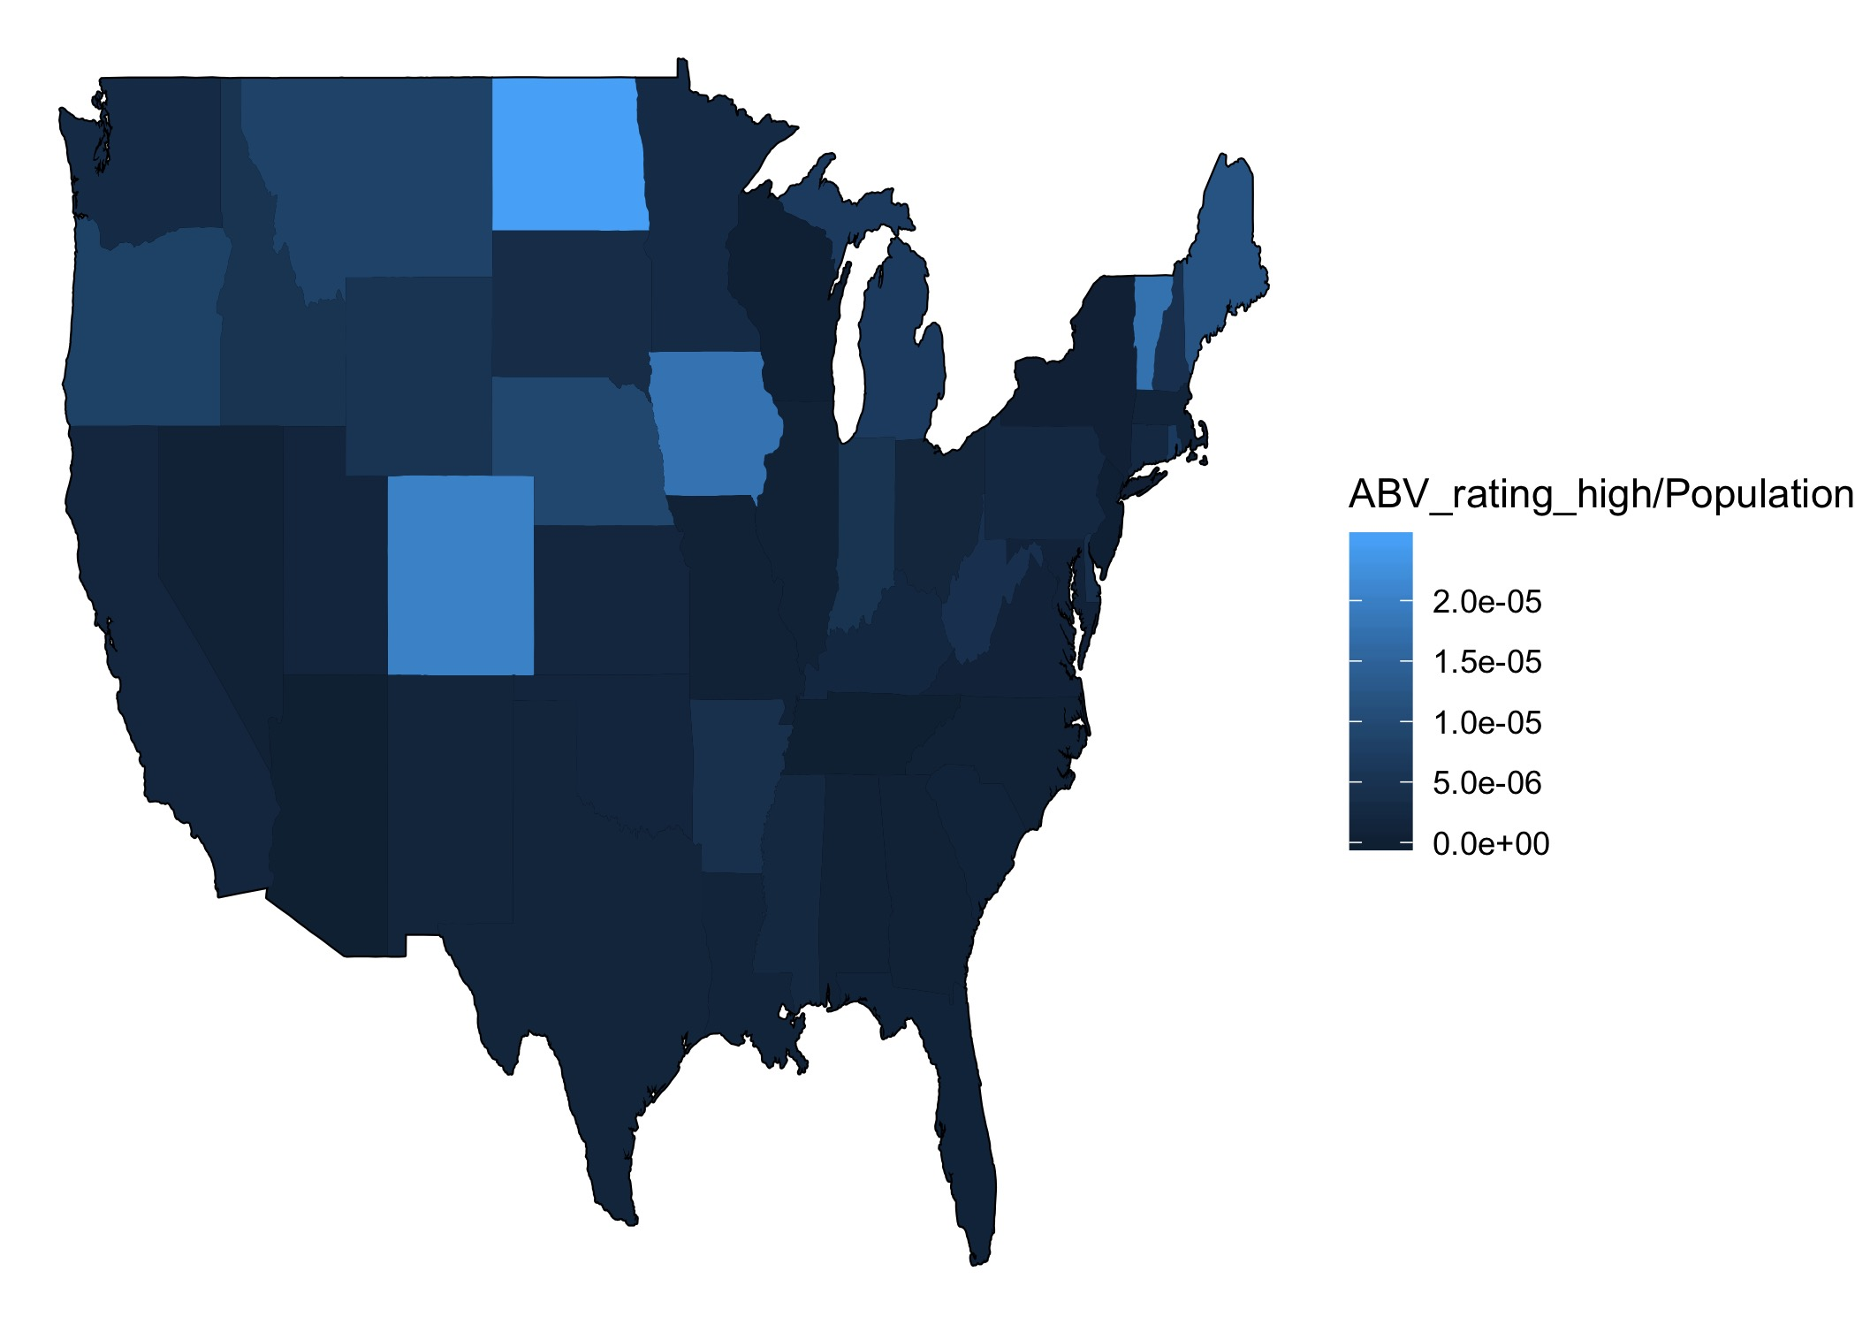
States ABV High

Slide 15
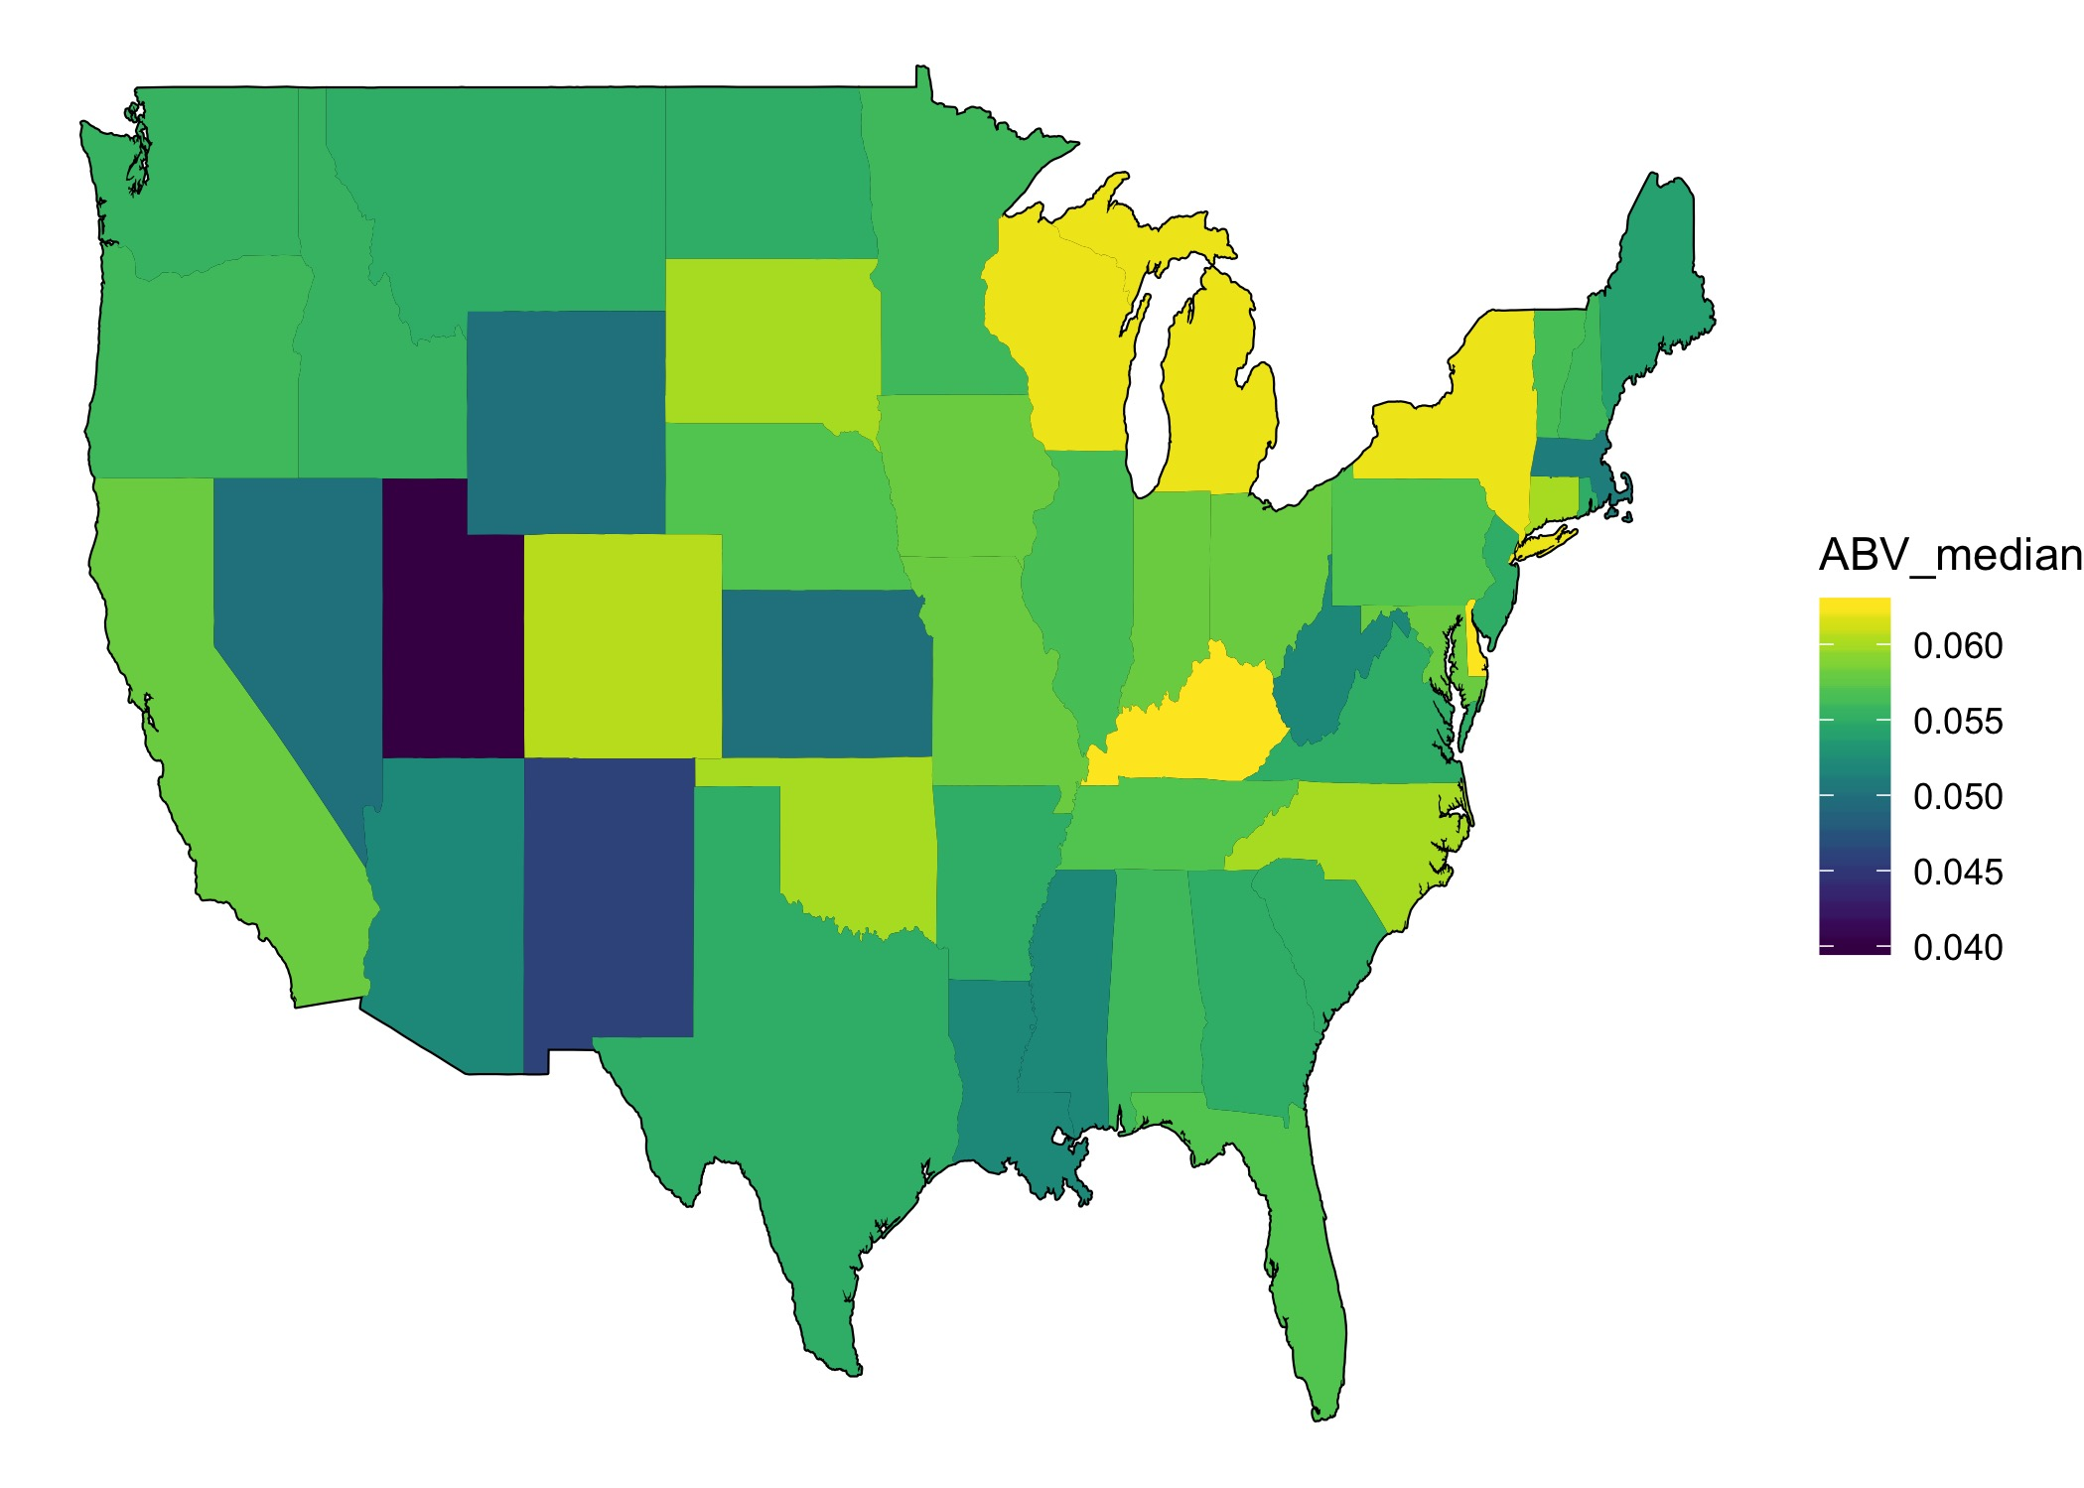
States ABV Ratings

Slide 16
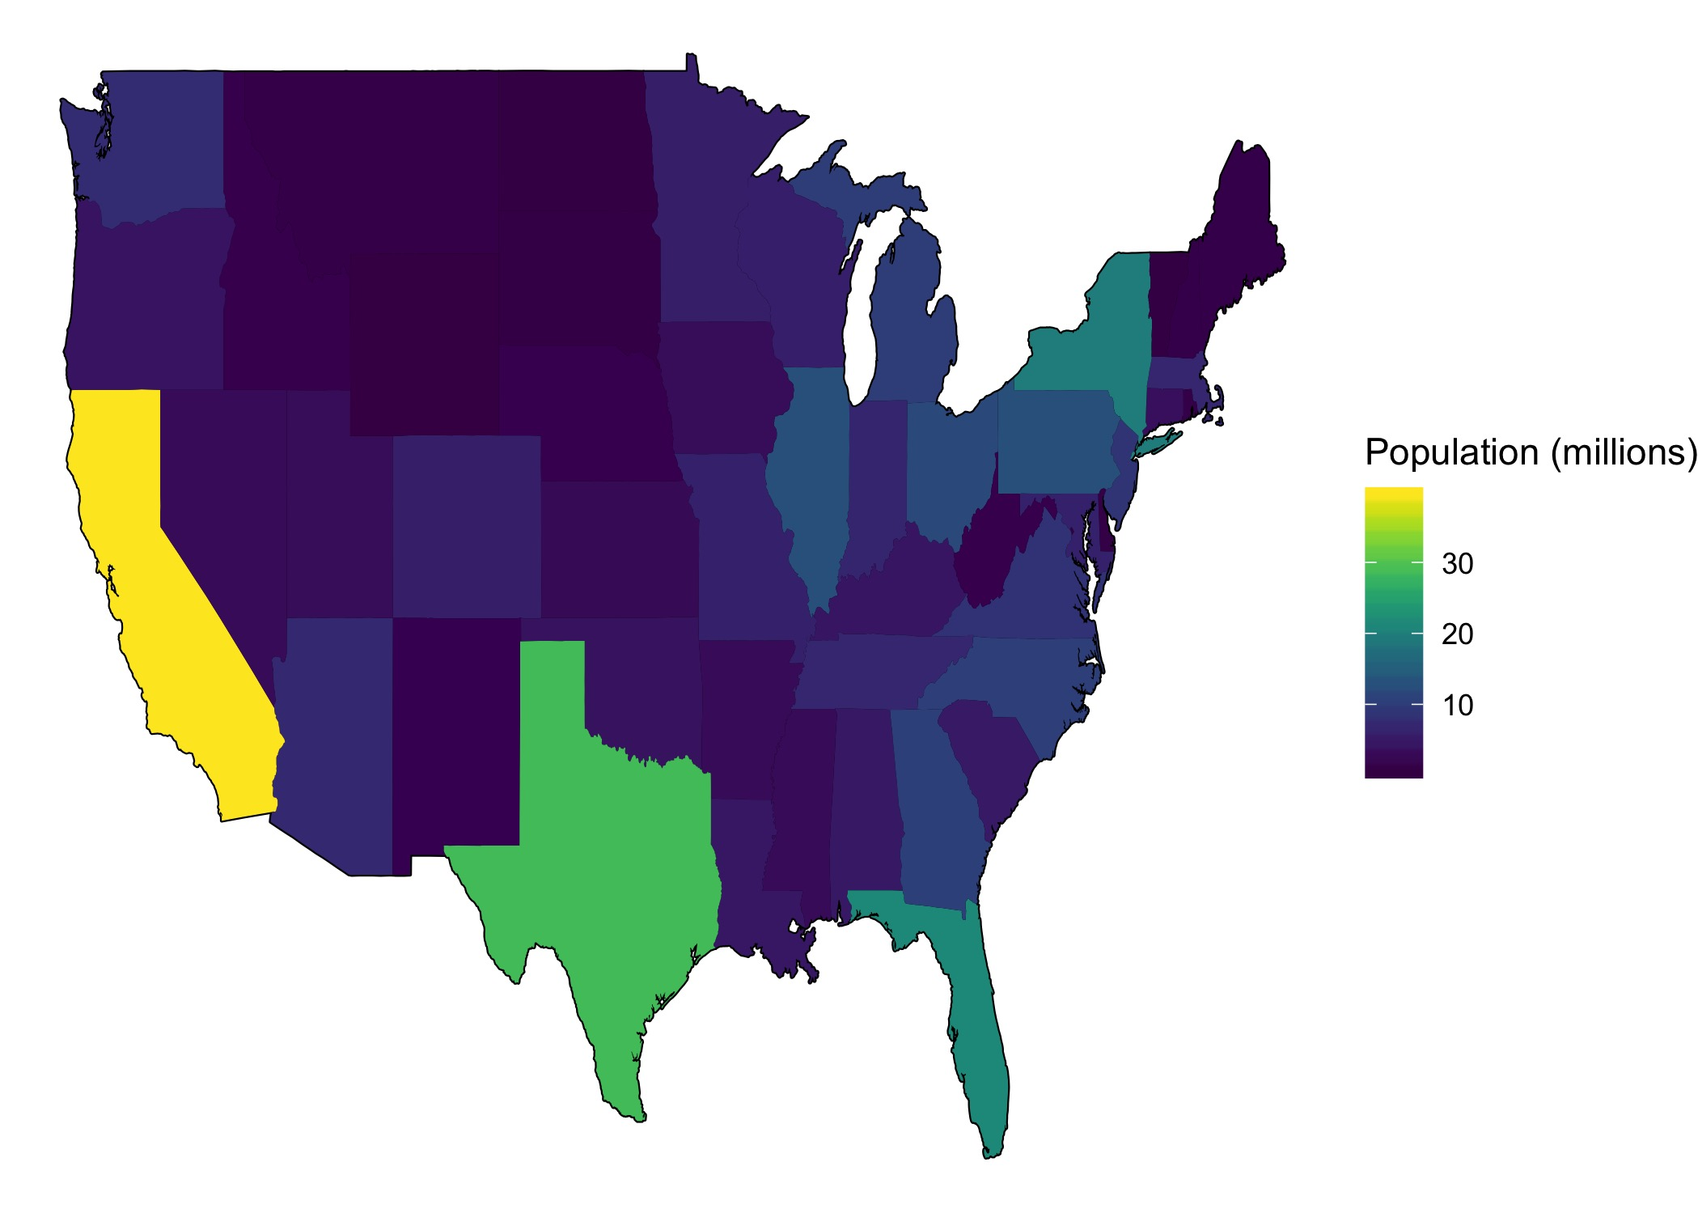
States Brewers Ratings

Slide 17
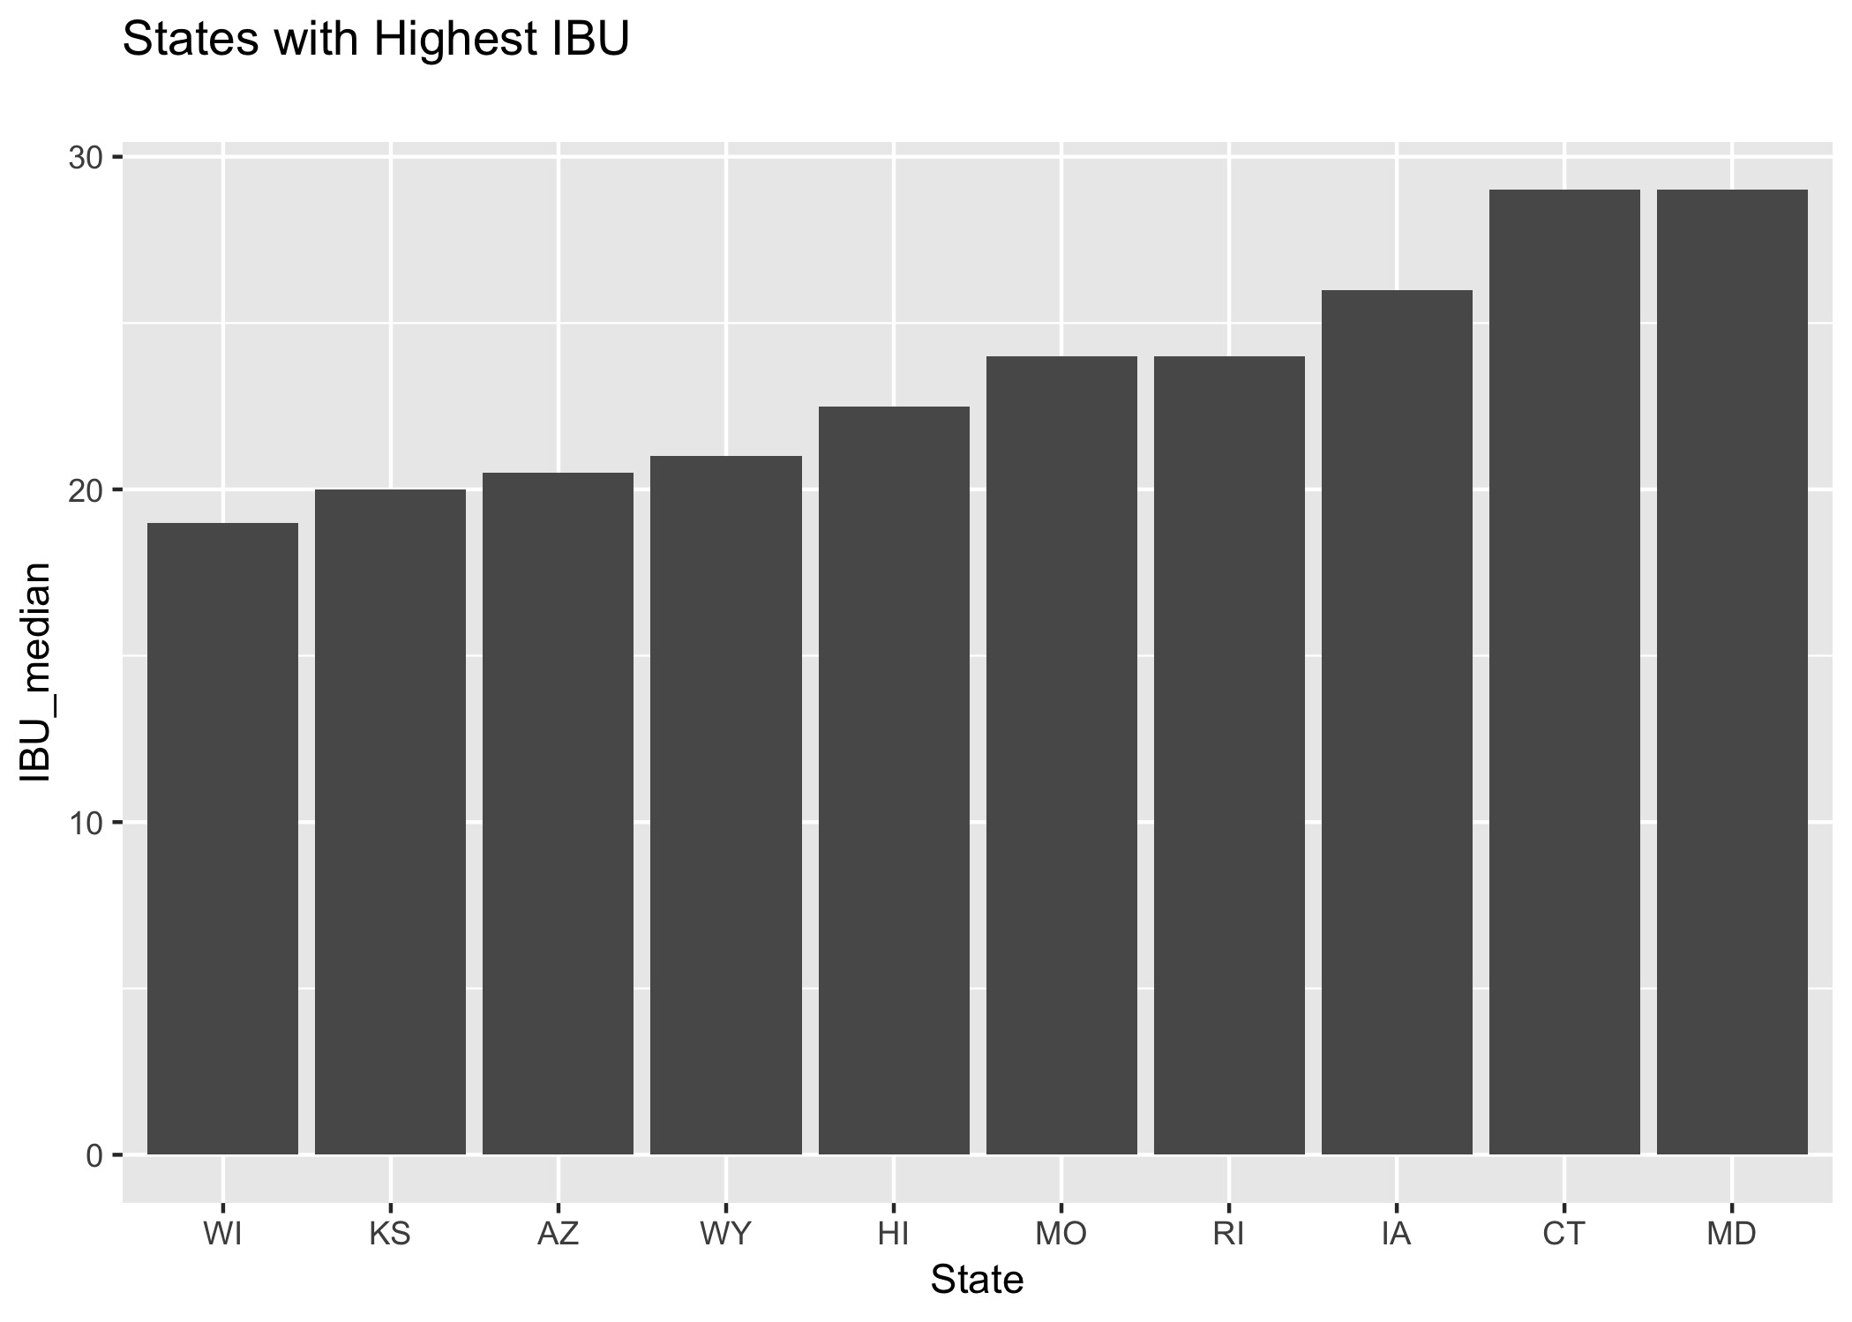
States with High Median ABV and IBU

Slide 18
Highest ABV & IBU by State
State with the most ABV beers is CO
State with the most IBU beers is CO

Slide 19
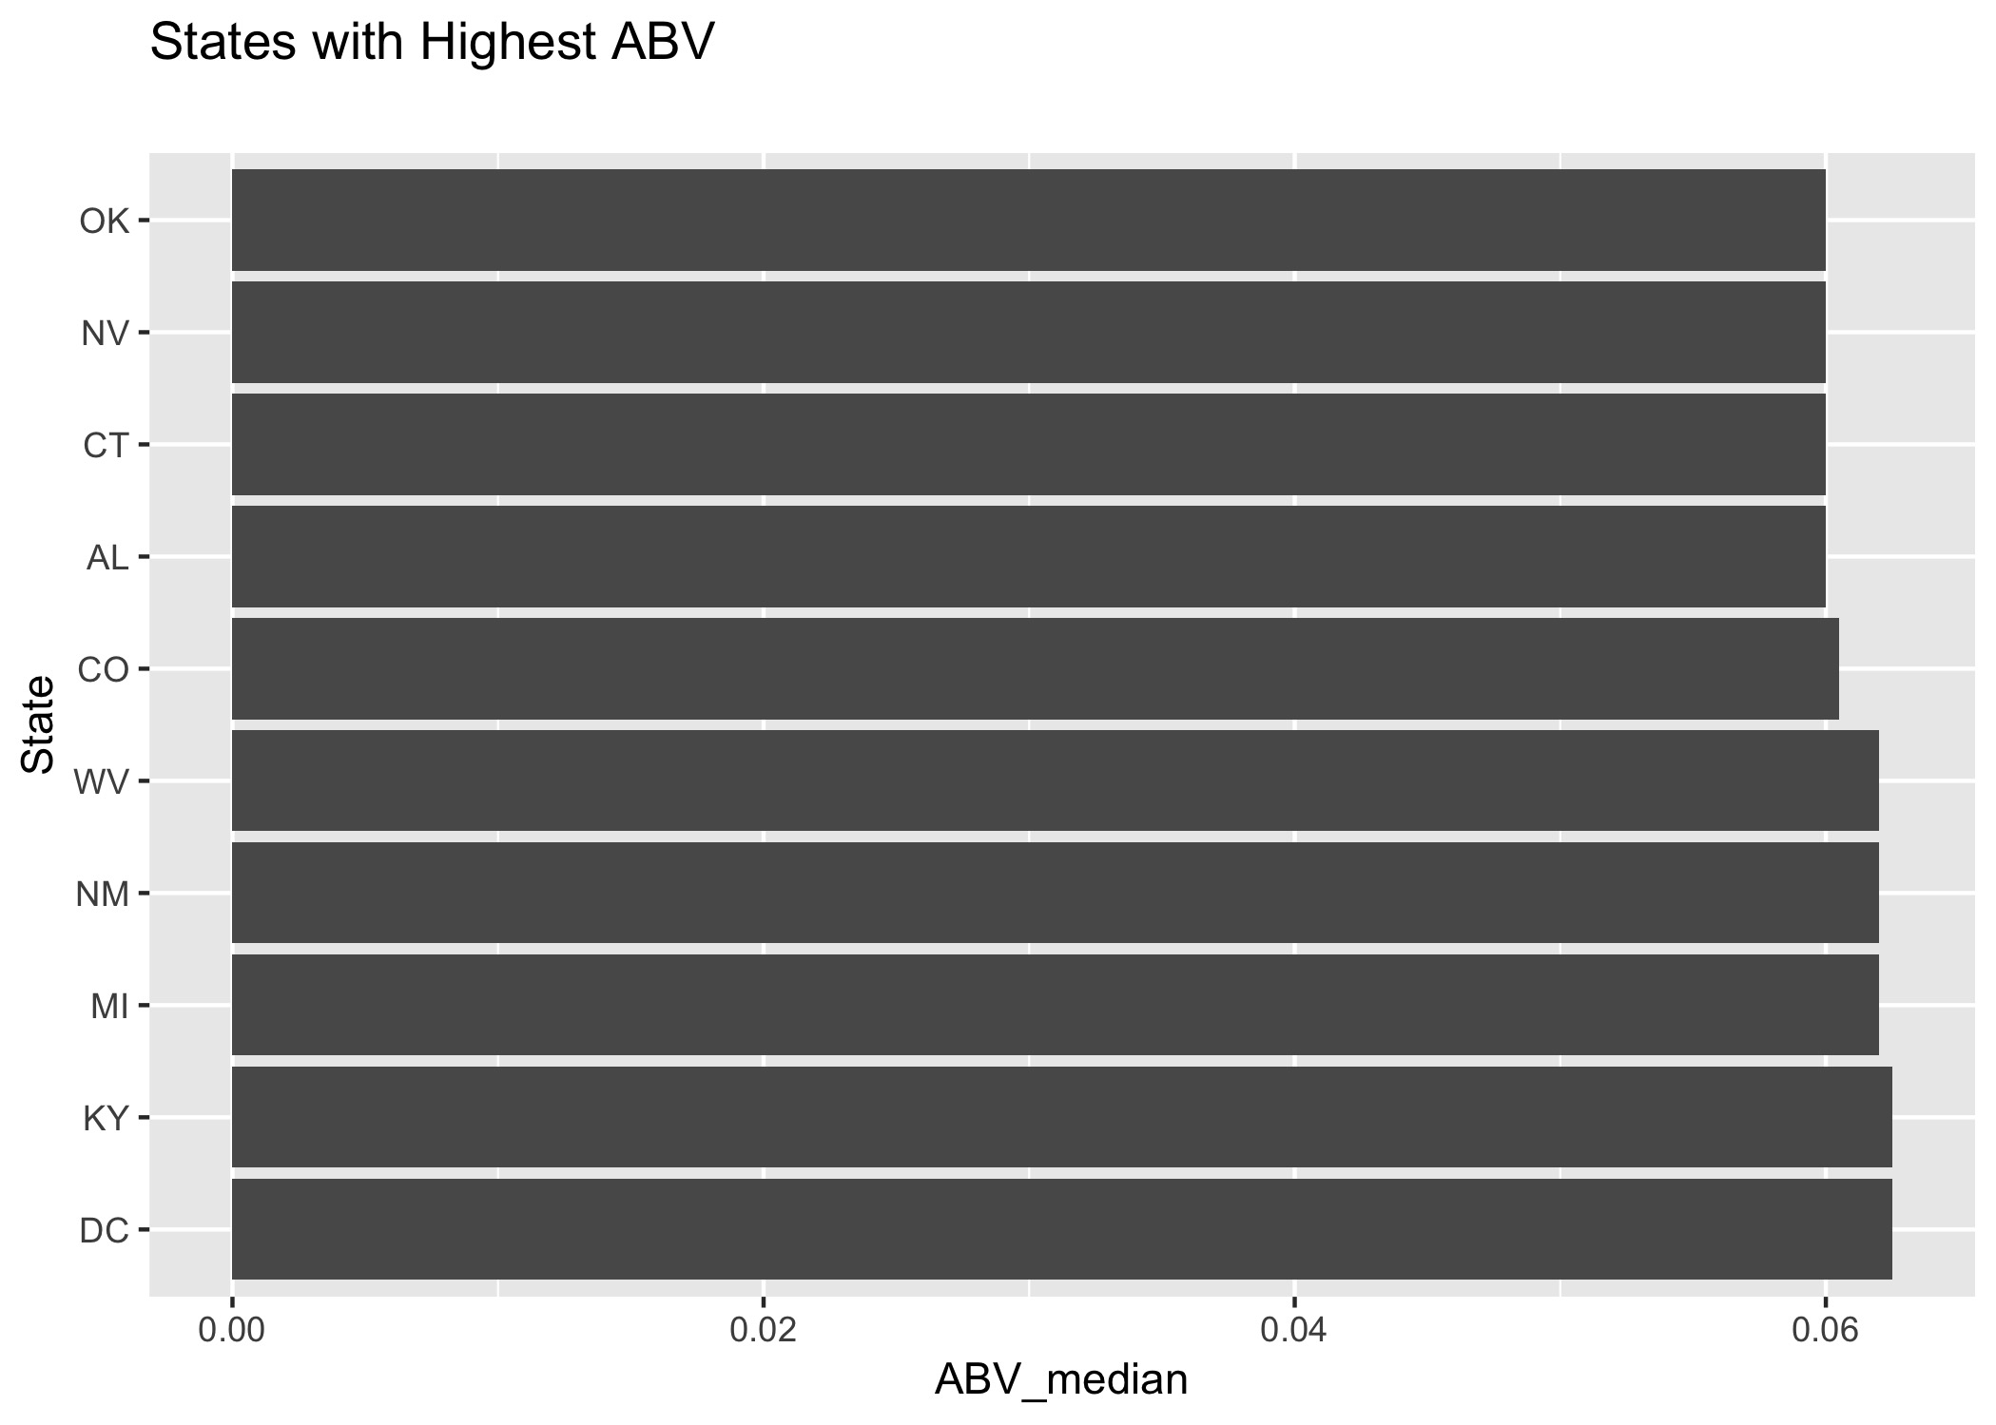
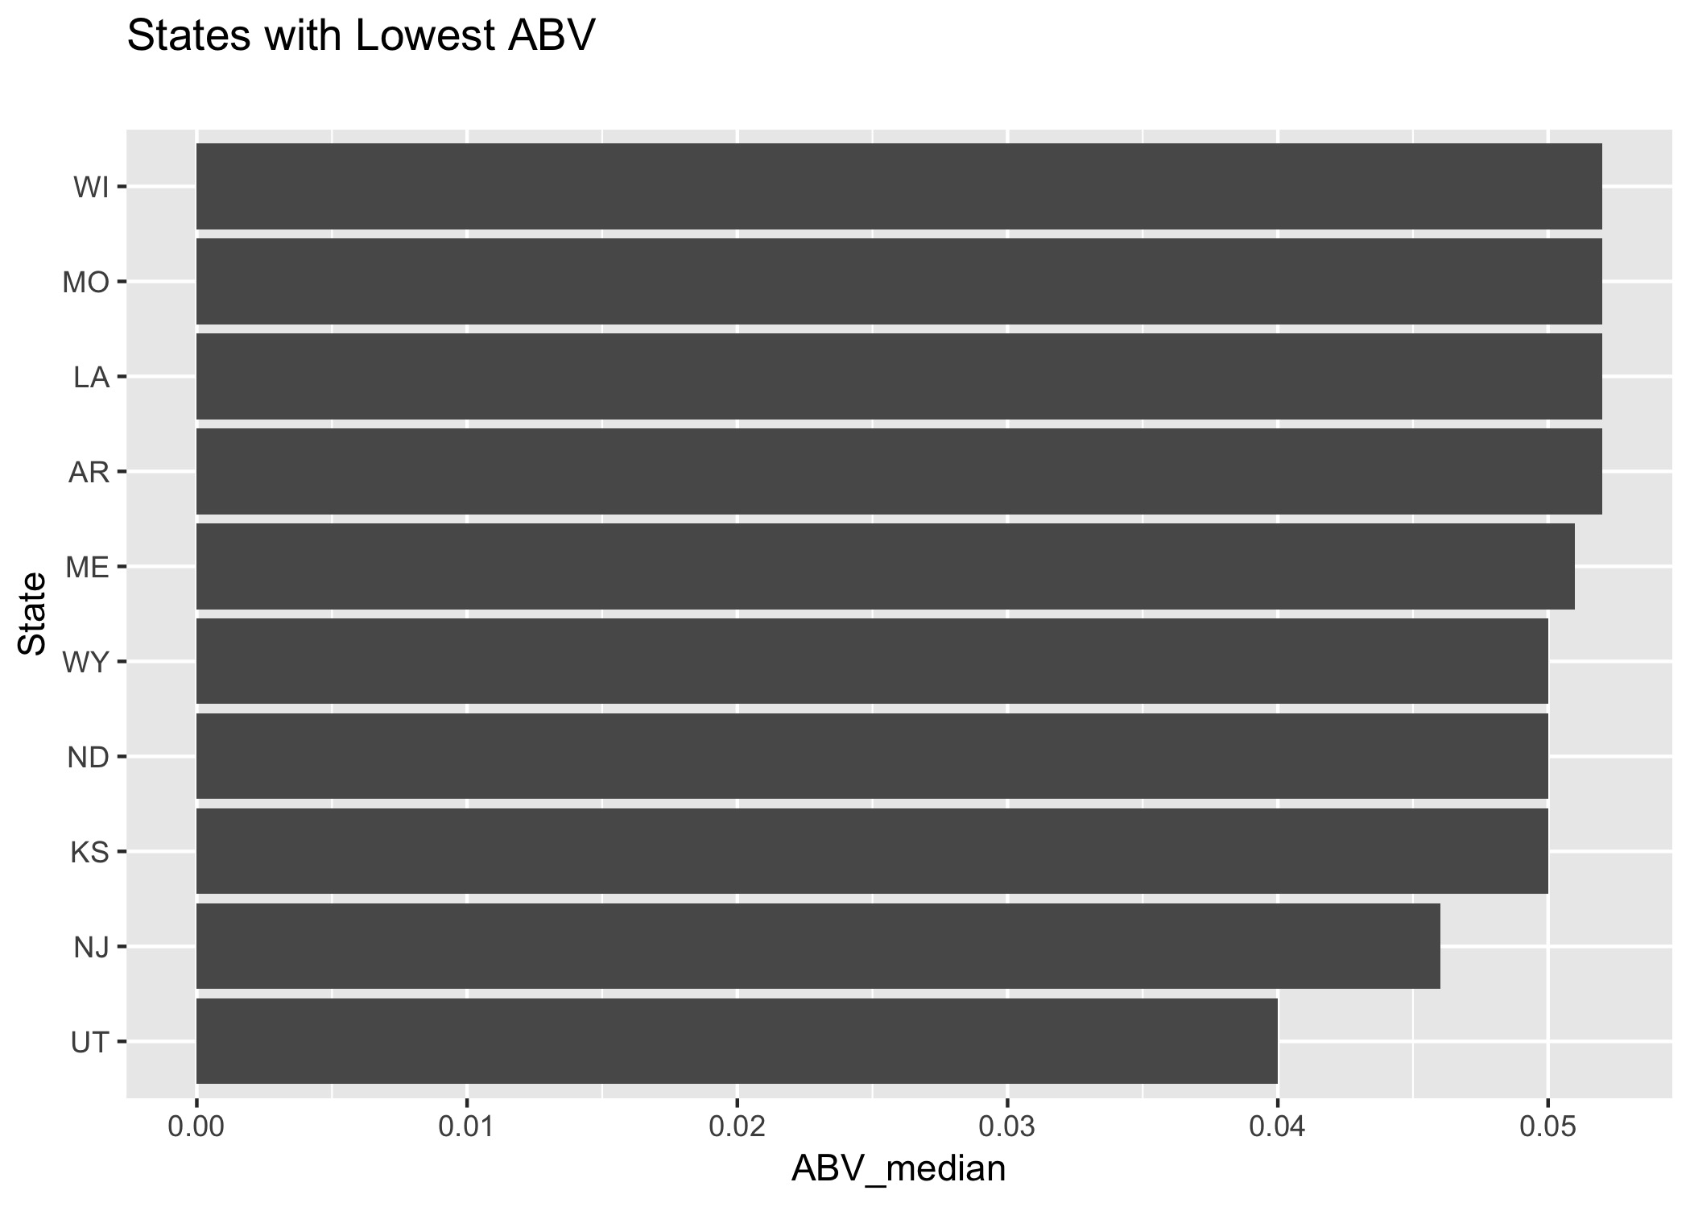
Summary ABV Top and Bottom by States

Slide 20
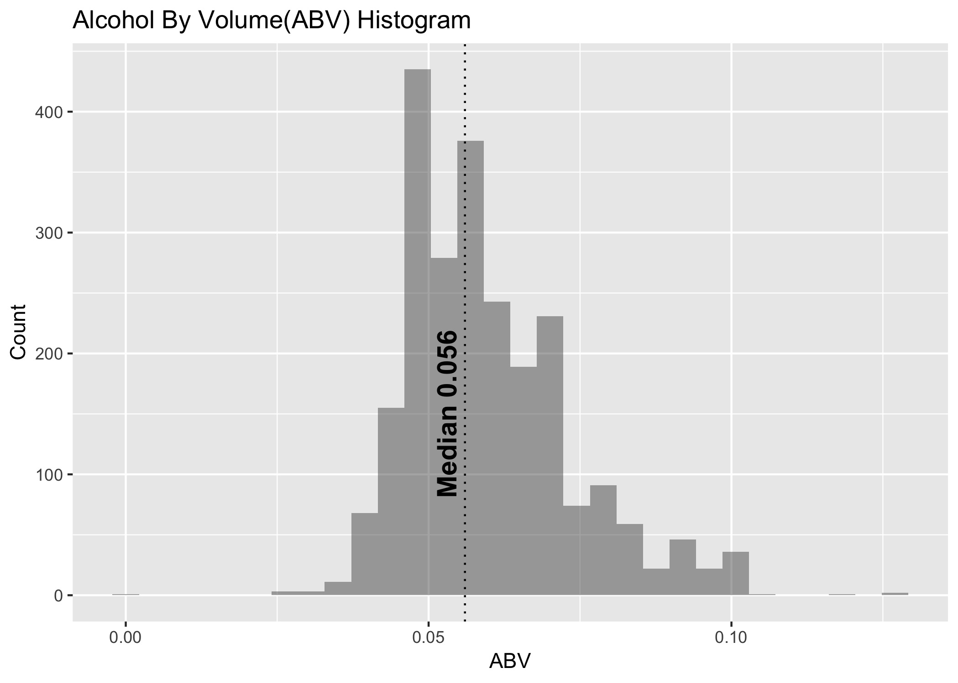
Alcohol by Volume

Slide 21
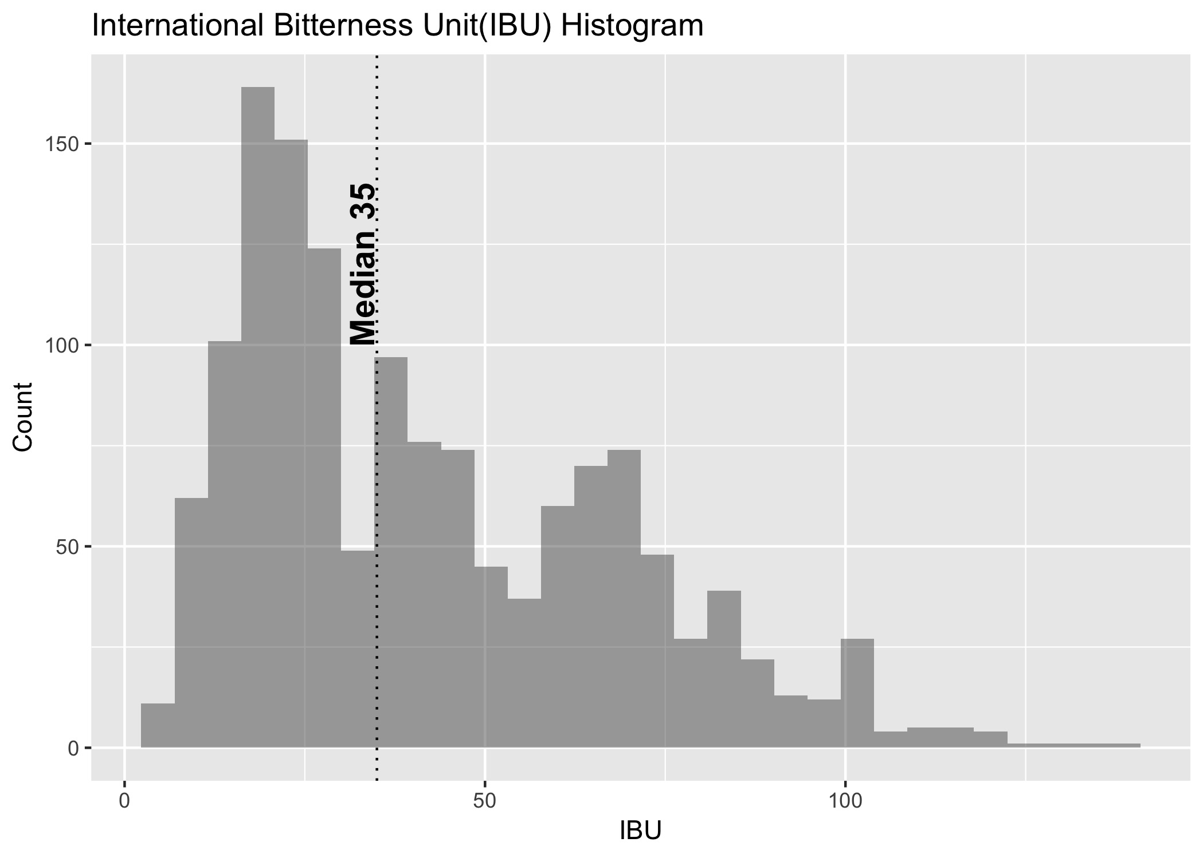
Bitterness by Volume

Slide 22
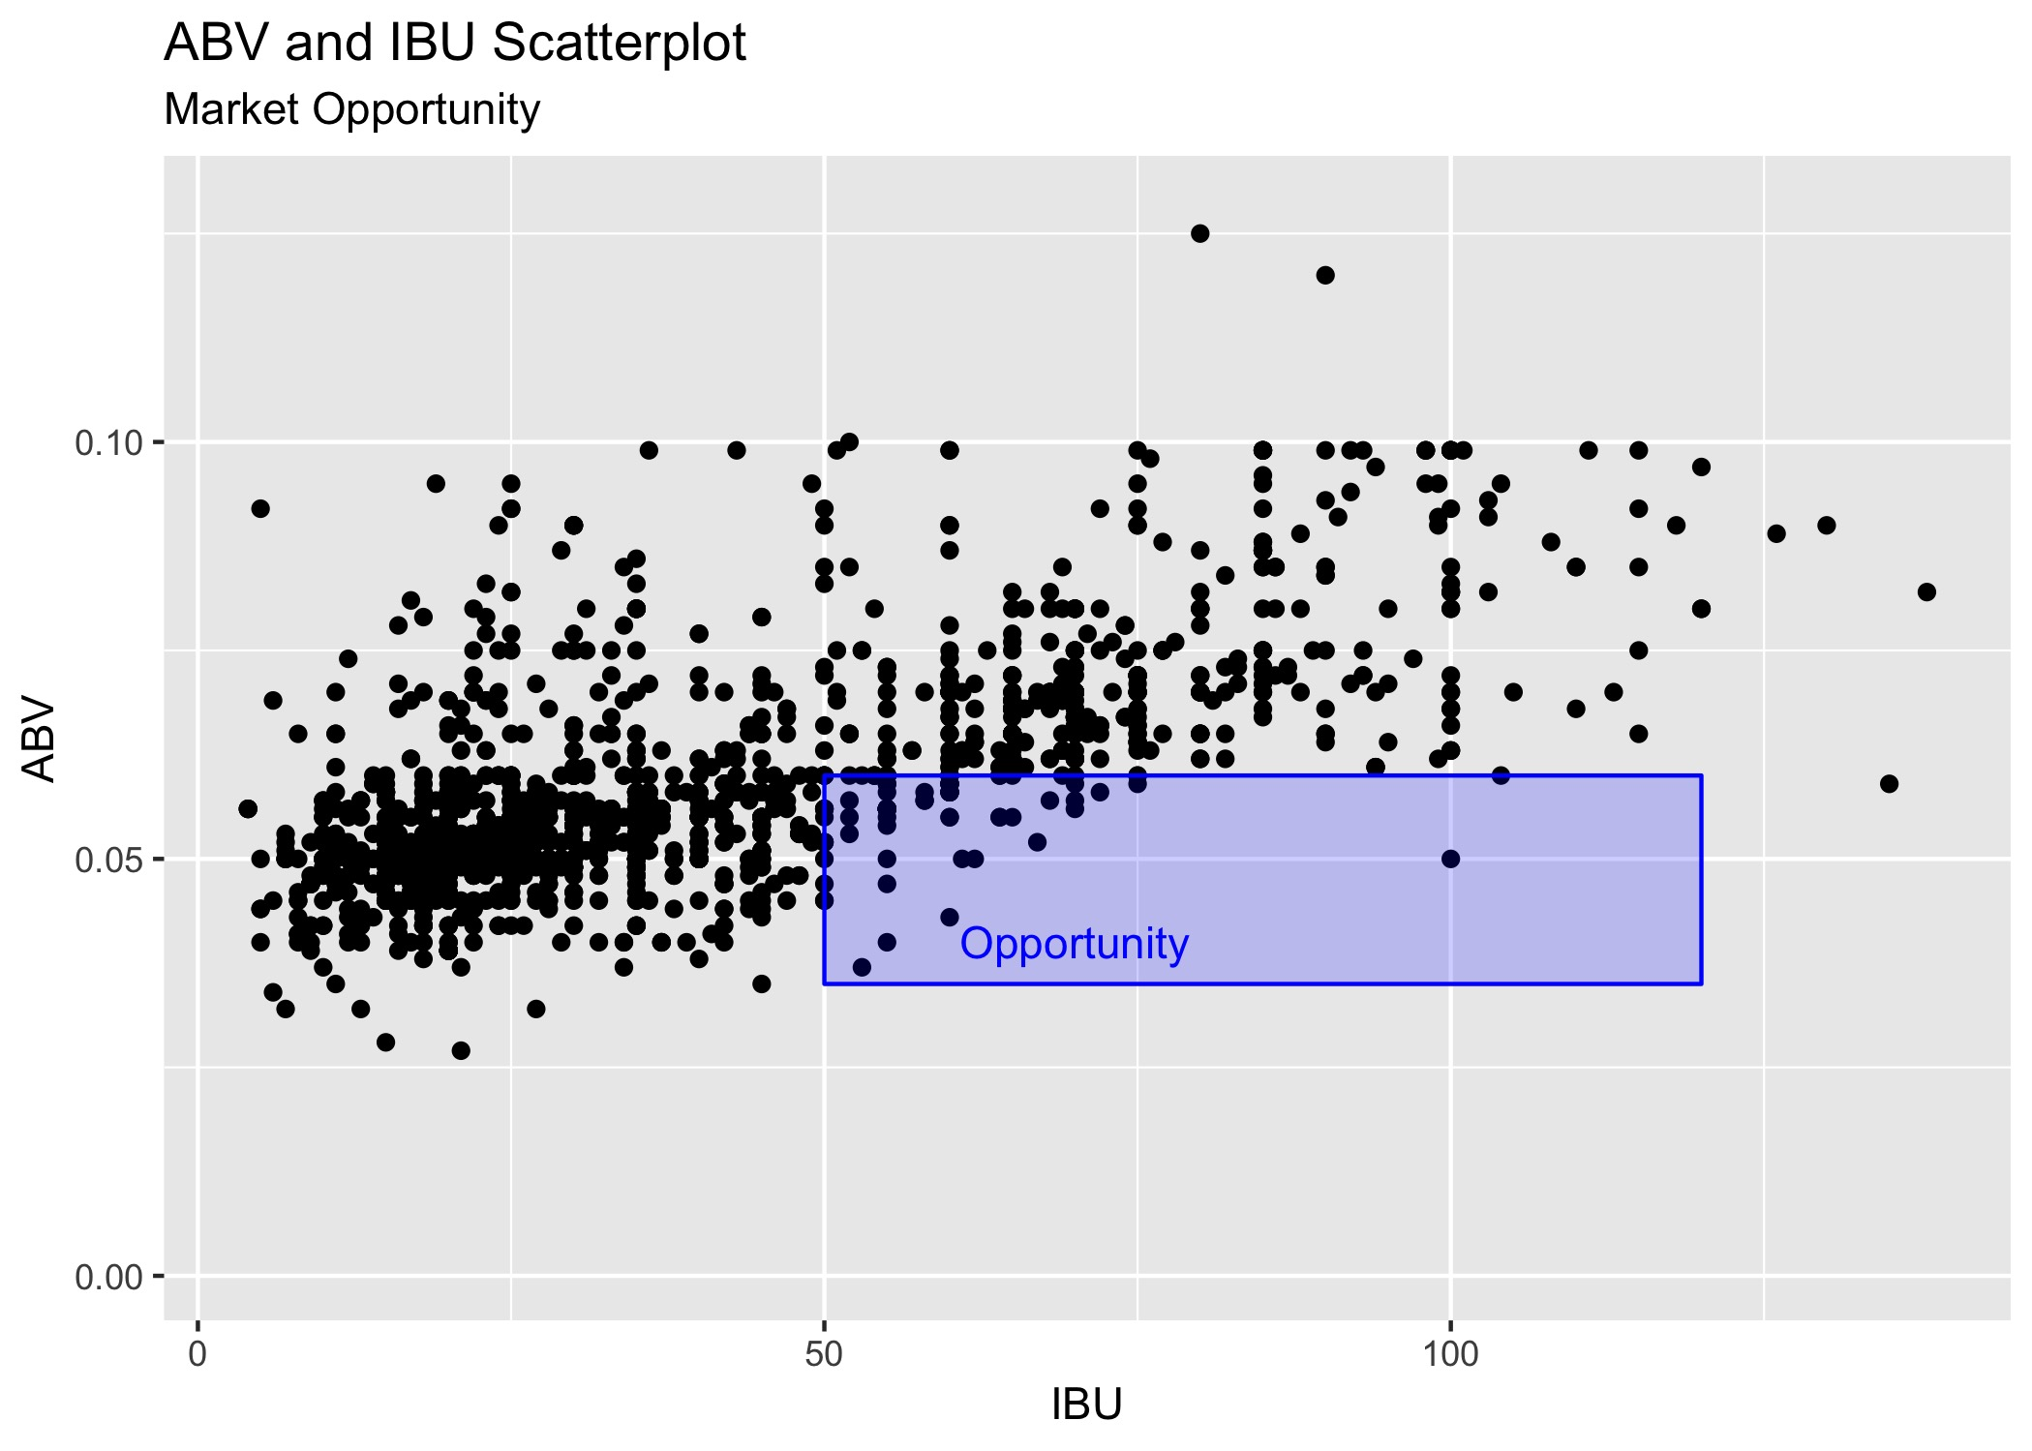
Relationship Between ABV and IBU

Slide 23
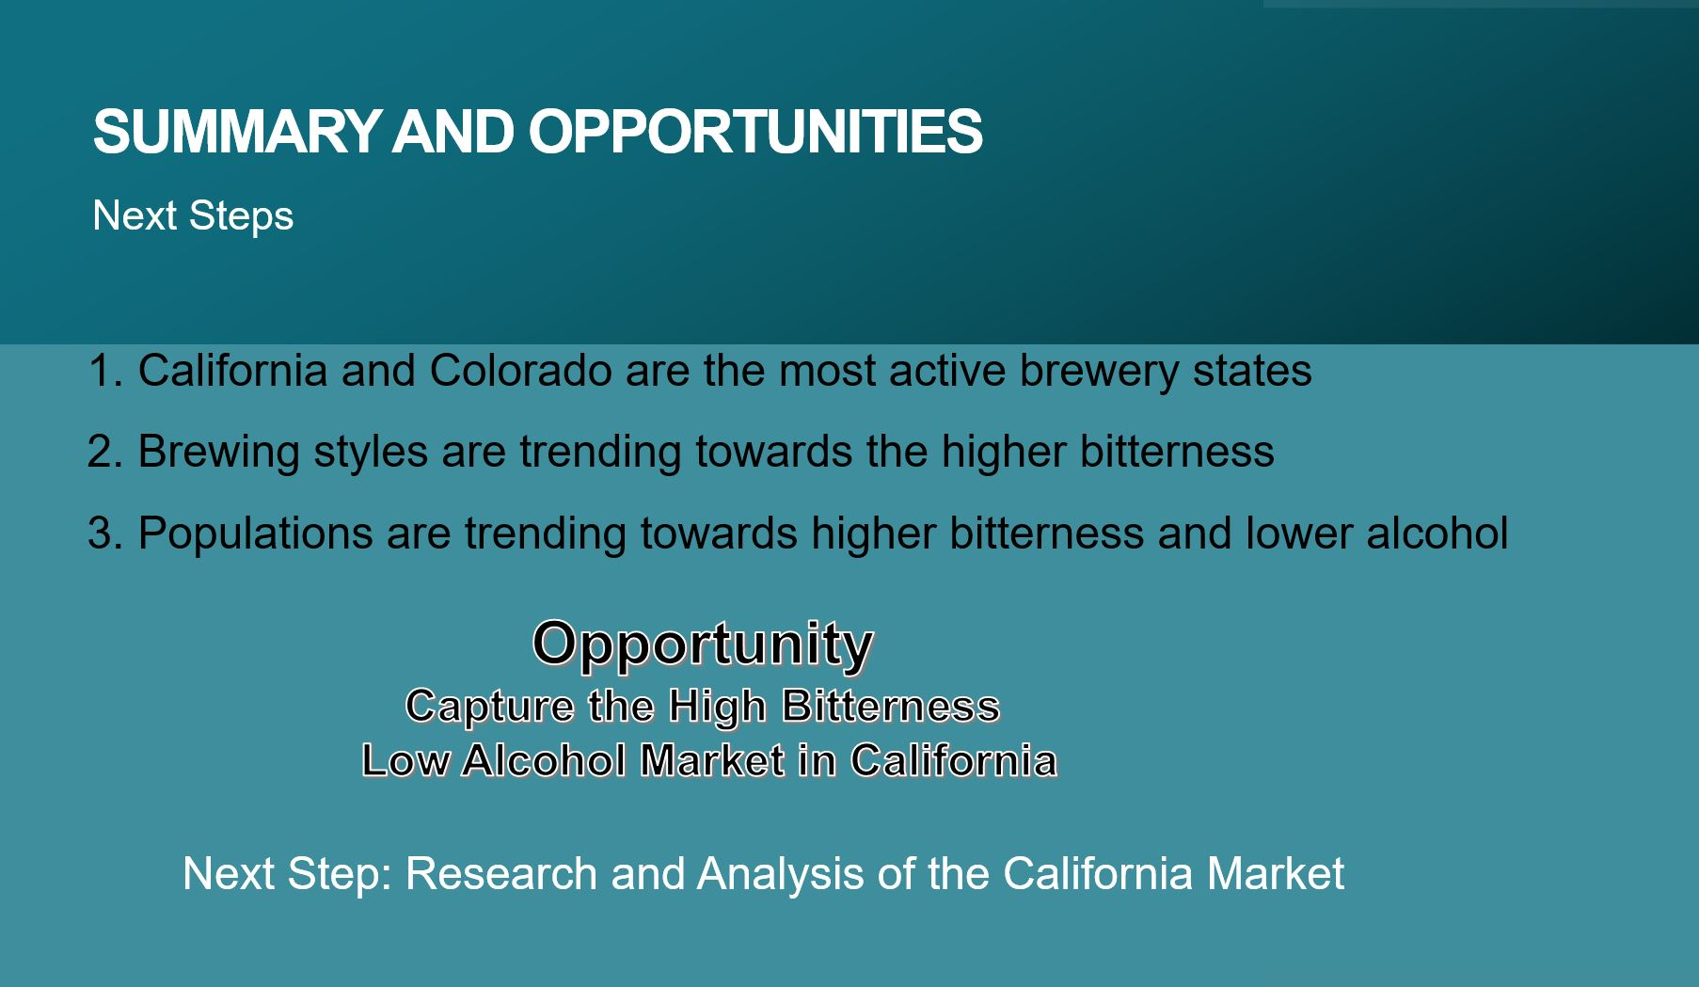
Summary and Opportunities

Slide 24
